Slide 1
Homework Assignments
Cancer Genetics Workshop
TONIGHT: view the “cancer as a genetic disease” video clip and complete the related worksheet
FRIDAY: bring your completed worksheet and be prepared for small group workshop and discussion
Use www.genecards.org to look up the function of your 3-4 genes. Fill in the details for your genes in the “Cancer Genes” discussion board on the canvas site.
Prep for next week
Read chapters 3 & 4
Complete the “mini-review” homework by Sunday at midnight
Open book
To be completed independently, within an hour

Slide 2
Week 1: Objectives
Be able to define what is a cancer gene and understand the distinction between the function of a gene in normal cells and in cancer cells
Be able to define “oncogene” and “tumor suppressor” and know how their functions are typically altered in cancer.
Be able to describe several ways in which gene function is altered in cancer, and what the consequences are for the gene product (protein)’s function

Slide 3
Cancer is a disease of cell proliferation
The human body has ~30 trillion cells
~10,000 trillion cell divisions in a lifetime
200 million cells are dividing in your body RIGHT NOW
Each division is an opportunity for a new mutation to be acquired and passed on

Slide 4

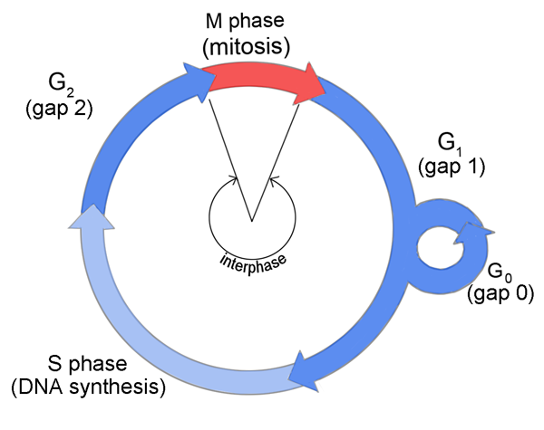
mis-regulated cell proliferation
To be tumorigenic, a cell MUST proliferate inappropriately to generate additional cancer cells
Cell size?
Replication complete?
DNA damage?
Spindle assembly?
Chromosome attachment?
Cellular checkpoint:
Monitor internal and external signals
Stop proliferation and prevent cell division when appropriate conditions are not met
Cell size?
Nutrients available?
Growth Factors present?
DNA damage?

Slide 5
mis-regulated cell proliferation
To be tumorigenic, a cell MUST proliferate inappropriately to generate additional cancer cells
Cell size?
Replication complete?
DNA damage?
Spindle assembly?
Chromosome attachment?
Tumor suppressors: Genes that enforce these checkpoints
proto oncogenes/oncogenes:
Genes that promote cell cycle progression
Cell size?
Nutrients available?
Growth Factors present?
DNA damage?

Slide 6
Unregulated cell proliferation
KEY to cancer development
Failure to respond to ‘stop’ proliferation signals
→ Loss of tumor suppressors allow cells to ignore internal and external signals that would otherwise limit cell cycle progression
Inappropriate or sustained entry into the cell cycle
Activation of oncogenes promotes cell cycle entry or continued proliferation even when conditions are unfavorable
What does this mis-regulation look like?

Slide 7
Can you design an experiment to monitor cell cycle progression?
2 min as a group:
Think about cell biology and what is distinct about each stage of the cell cycle
Write a list of key activities from each stage of the cell cycle (G1, S, G2, and M)
5 more minutes as a group
Can you propose a way scientists may determine what stage of the cell cycle their cells are in?
Hint: consider
Analysis of protein localization
Analysis of protein levels
Analysis of mRNA levels

Slide 8
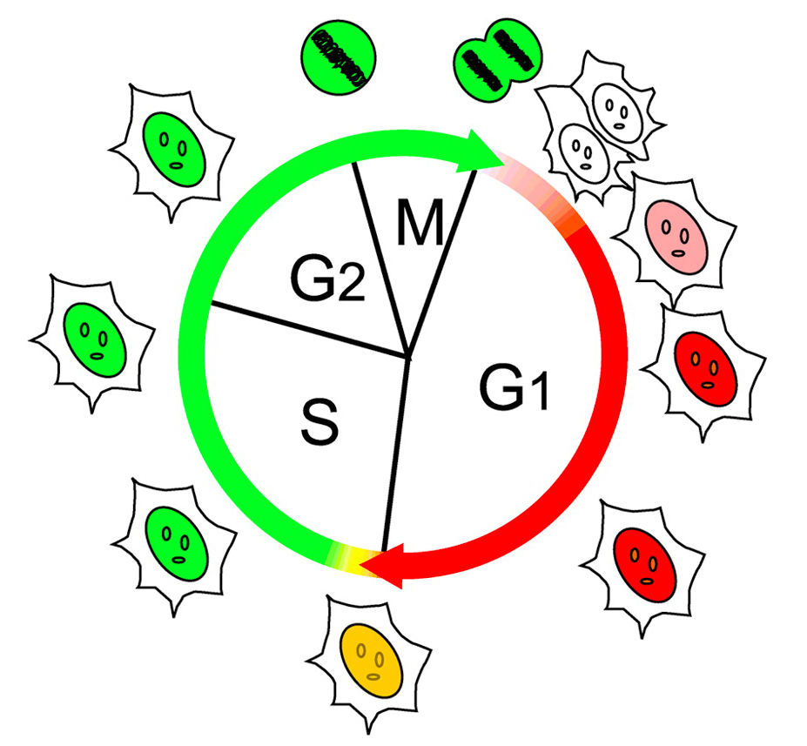
Cell cycle checkpoints at work
Experimental tools:
Molecular biology to genetically engineer cells to enable visual monitoring of cell cycle
DNA sequence encoding proteins that fluoresce at cellular pH are integrated into the genome under the regulation of promoters that are expressed at specific stages of the cell cycle
A red fluorescent protein tagged Cdt1 is expressed during the first gap phase of the cell cycle (G1)
A green fluorescent protein tagged Geminin is expressed during the DNA synthesis stage (S) of the cell cycle

Slide 9
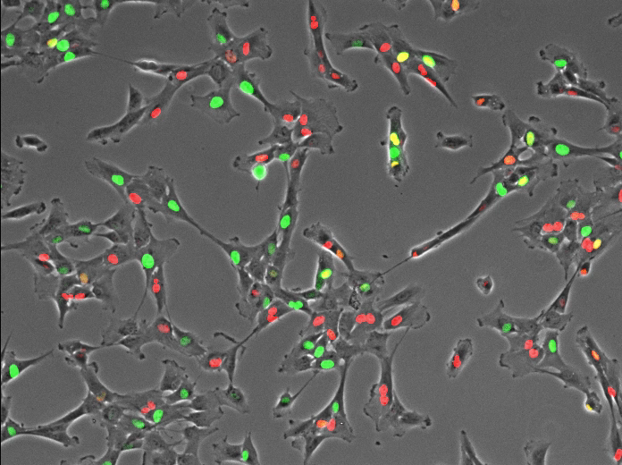
Cell cycle checkpoints at work
Normal cells cycle from red to green as they progress through the cell cycle

Slide 10
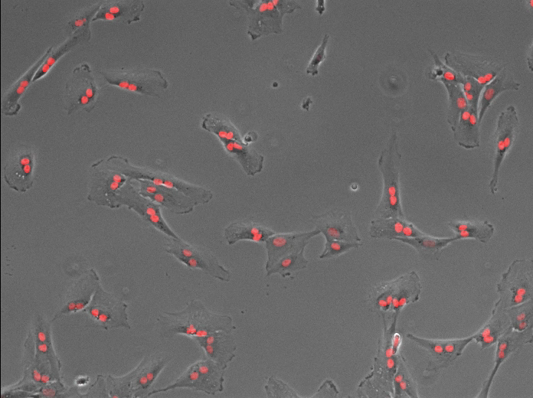
Cell cycle checkpoints at work
+ DNA Damage
Checkpoints are activated only when something goes wrong
When cells are damaged during division, they arrest in the subsequent G1

Slide 11
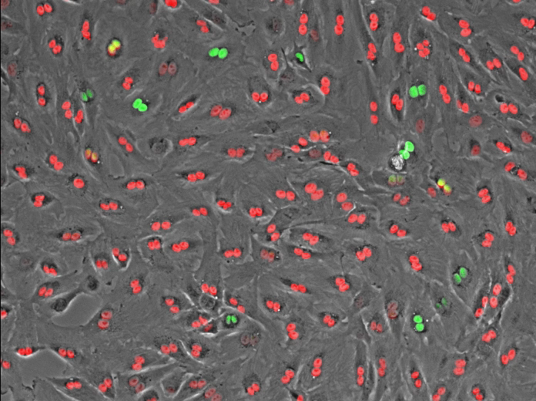
Cell cycle checkpoints at work
Damaged Cells with
Compromised Checkpoint
+ DNA Damage
When the checkpoint is compromised, damaged cells continue to cycle
The ability to bypass checkpoints is a common feature in cancer cells

Slide 12
Loss of tumor suppressor function is often a first step in tumorigenesis
Why might loss of a tumor suppressor be more common than activation of an oncogene?

Slide 13
Cells accumulate mutations as they proliferate
Mutations that are advantageous for cell growth and survival are passed on to daughter cells
Acquisition of more mutations with subsequent cell cycles may eventually lead to cancer

Slide 14
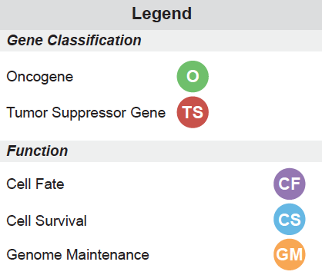
What gene mutations cause cancer?
Each part represents a real patient whose tumor genome has been sequenced to identify “cancer genes” responsible for that tumor’s growth
Group according to the 8 types of cancer: (hepatic, colorectal, leukemia, melanoma, breast, pancreatic, glioma, and lung)
What trends emerge?
Group according to patient number (1, 2, 3, 4)
What is similar among patients/tumors? What is different?

Slide 15
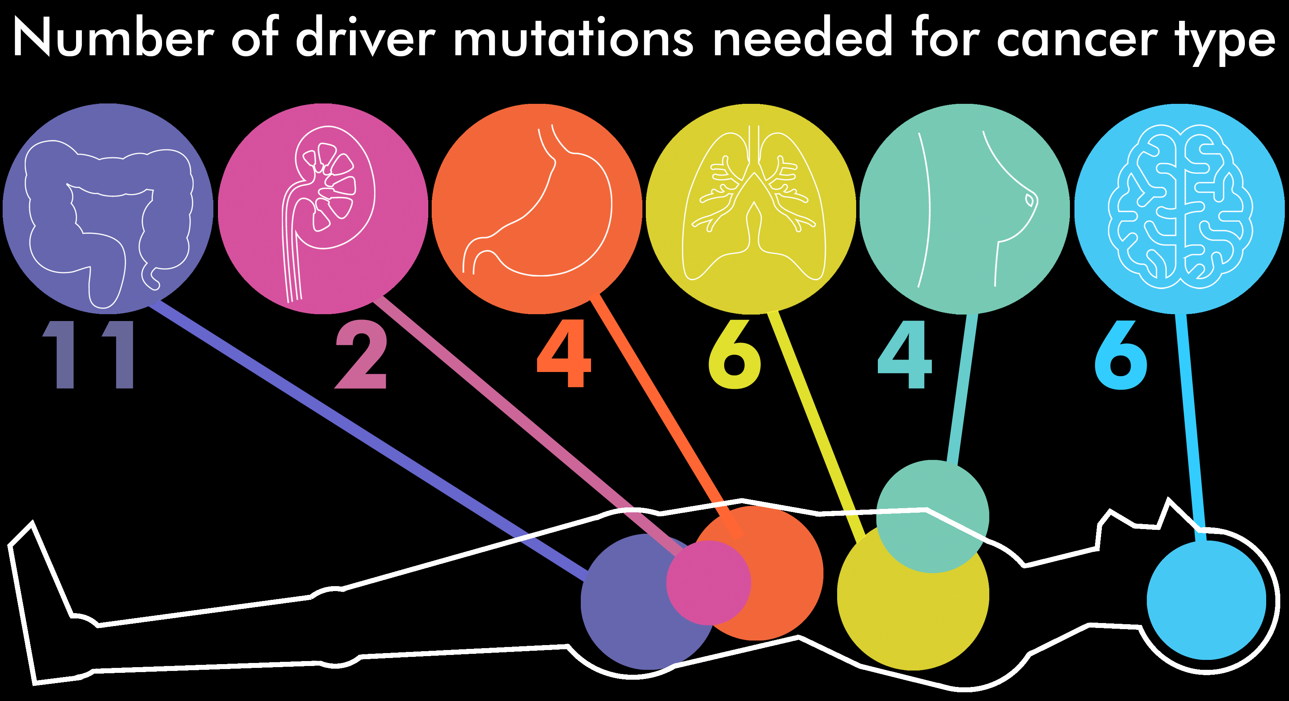
Cancer is a genetic disease
Most cancers are driven by 6-9 different gene mutations

Slide 16
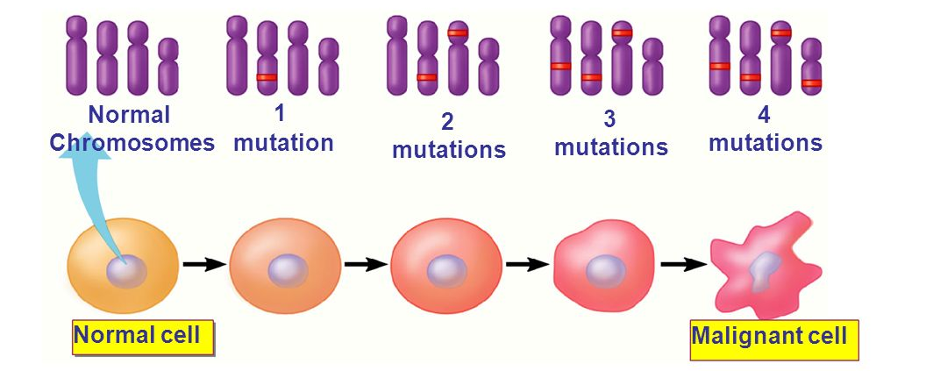
Cancer is a genetic disease
Cancer arises from the accumulation of genetic changes (mutations) over time

Slide 17
Cancer genes are found throughout the genome
Mutations are also occurring in non-cancer genes
Carrier mutations and driver mutations may have the same underlying cause, but only driver mutations cause the cancer.
Cells continue to acquire mutations as the cancer evolves → contributes to genetic heterogeneity in the tumor

Slide 18
Cancer Cell Evolution
Aneuploidy enables cancer cells to evolve resistance
to cancer therapies
Ongoing mutations:
Very heterogeneous in a few division cycles
→ Different (colored) cells have different mutations

Slide 19

Cancer Cell Evolution
Heterogeneity enables cancer cells to evolve resistance
to cancer therapies
+ Cancer therapy!
Ongoing mutations:
Very heterogeneous in a few division cycles
→ Different (colored) cells have different mutations
Chemotherapy kills most cancer cells
→ tumor shrinks!
Some cells evolve to be resistant to therapy
→ some cancer cells remain
Notes:
Now when the patient with this tumor is treated with chemotherapy drugs, because not all the cancer cells have the same genetic material, they may not all respond similarly to the cancer treatment. Some cells, by virtue of their different aneuploidy may have evolved to be resistant to therapy.

Slide 20
Cancer Cell Evolution
Heterogeneity enables cancer cells to evolve resistance
to cancer therapies
Ongoing mutations:
Very heterogeneous in a few division cycles
→ Different (colored) cells have different mutations
Chemotherapy kills most cancer cells
→ tumor shrinks!
Some cells evolve to be resistant to therapy
→ some cancer cells remain
→ tumor relapses & is drug resistant
Mutations both cause cancer and promote cancer evolution

Slide 21
Genetics of Cancer
Chromosomes are altered in most types of cancer cells
Changes in DNA sequence
Changes in chromosome number

Slide 22
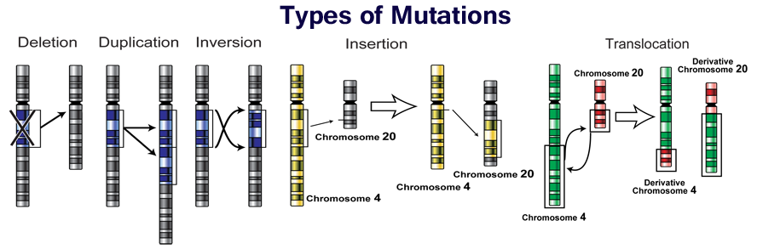
Mutations impact large areas of DNA
5 main types of large-scale genome mutations
Can impact single chromosomes
Can impact multiple chromosomes

Slide 23
How do these chromosome alterations happen?
Is there a common first step for all/most types of large-scale mutations?
Mutations in cancer result from an increase in DNA damage and/or a defect in damage repair
What could be the impact on genes at the boundaries of these mutations?
GROUP 3
GROUP 1
GROUP 2
GROUP 4
GROUP 5

Slide 24
Mutations can impact one or a few bases of DNA sequence
Mutations in a gene can disrupt the genetic code:
Normal Gene sequence: THE GAL SAW THE GUY EAT PIE
Point Mutation: THE GAL PAW THE GUY EAT PIE
Deletion: THE GAL THE GUY EAT PIE
Insertion: THE GAL SAW THE GUY EAT WPI E
Frame Shift: THE GAL SAW TGU YEA TPI E
DNA → mRNA → protein
Altered DNA = altered protein

Slide 25
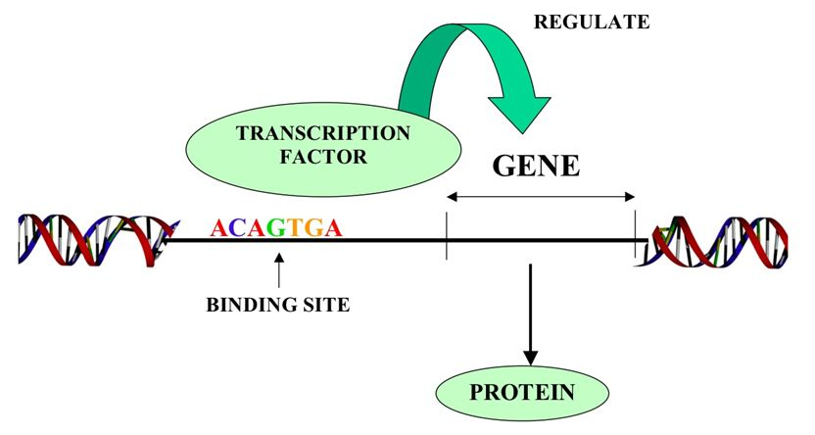
Mutations effect protein expression
Mutations near a gene can disrupt how it is regulated
Promoters, enhancers, transcription factors, etc bind to the DNA or mRNA with sequence specificity
Changes in the DNA sequence can alter how regulators bind and lead to changes in gene expression and protein production

Slide 26
single mutation, BIG impact
Proteins that are pleiotropic regulate other genes and can influence many cellular pathways
Transcription factors → regulate which mRNAs get made
Transcriptional regulators → regulate the transcription factors
Epigenetic regulators → regulate which genes are accessible to transcription factors
Mutation of a gene that encodes a pleiotropic factor will impact many pathways

Slide 27
pleiotropic factors in cancer
Ex: deletion mutation of a transcriptional or epigenetic regulator → loss of transcriptional regulation and massive de-regulation of it’s target genes
EX: Translocations can fuse two proteins → allow for new functions (gain of function) of the protein fusion
Could overexpression of a pleiotropic factor be a problem? How?
mRNA
TF
Epigenetic regulator
gene
TF
Gene
protein

Slide 28
Genetics of Cancer
Chromosomes are altered in most types of cancer cells
Changes in DNA sequence
Changes in chromosome number

Slide 29
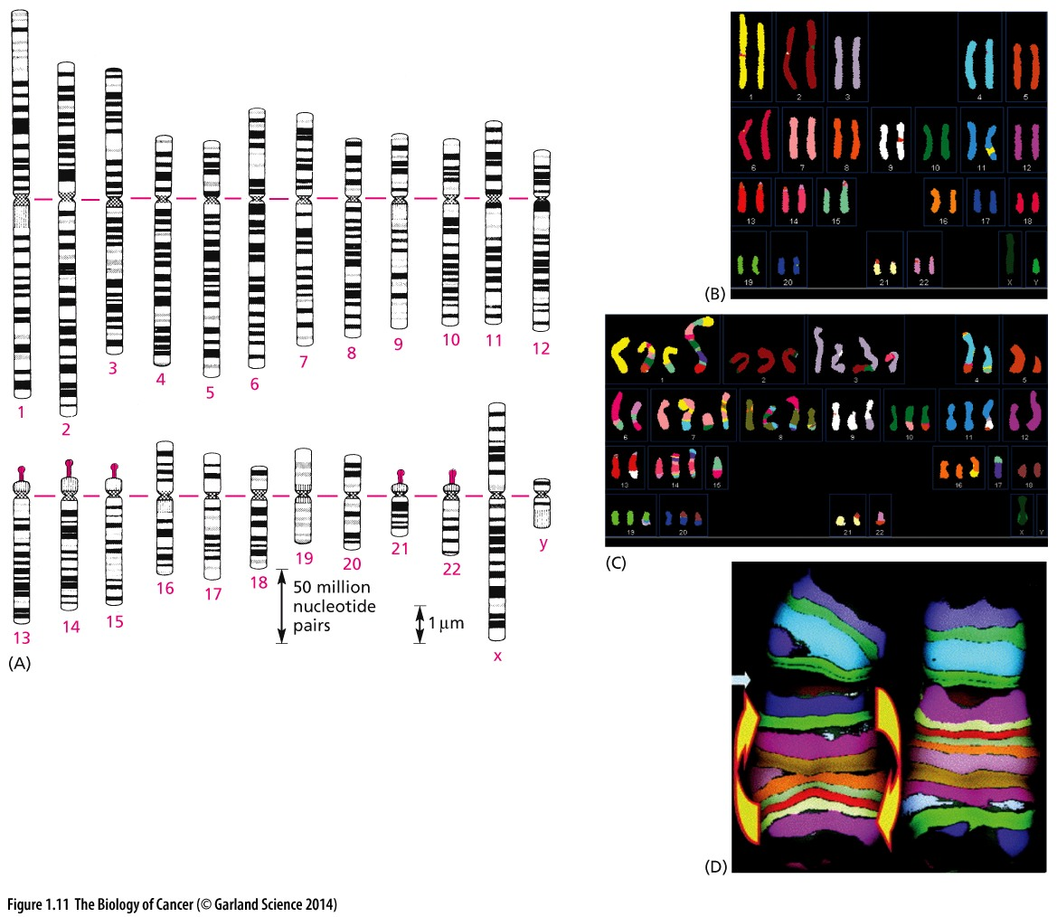
Chromosome copy number
Normal human cells have 23 pairs of chromosomes

Slide 30
Genetics of Cancer
Cancer cells have often gained or lost one or more chromosomes
Cells with an abnormal number of chromosomes are aneuploid
What pathway(s) would need to be corrupt to allow this to happen?
(hint: what normally ensures equal inheritance in each subsequent cell cycle)
Normal cell
Cancer cell

Slide 31
Genetics of Cancer
Cancer cells often have BOTH mutations AND copy number changes
Cancers that are difficult to treat often have complex karyotypes
Normal cell
Cancer cell

Slide 32
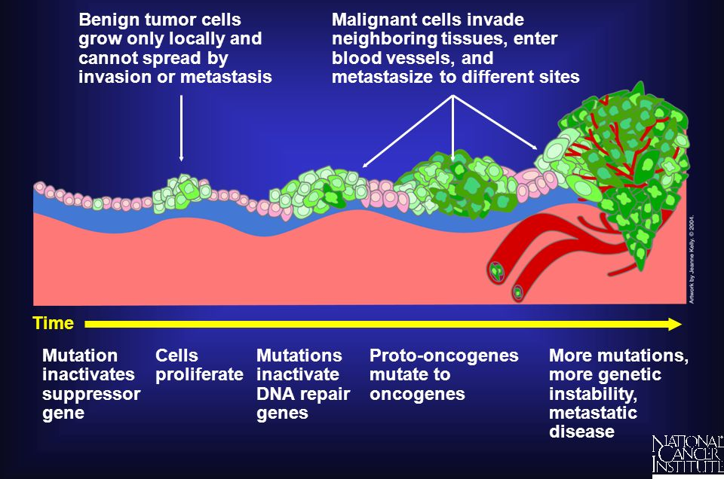
Mutations accumulate over time
Individual mutations can contribute to one or more step in tumorigenesis
How might scientists determine which step a mutation is important for?

Slide 33
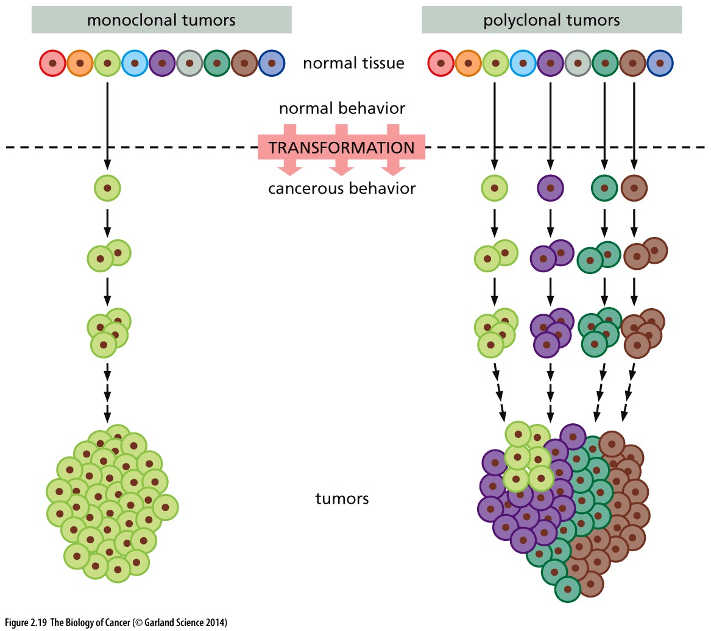
Cancers are clonal
Mutations that happen early in tumorigenesis (tumor-initiating mutations) are present in all cancer cells of the tumor

Slide 34
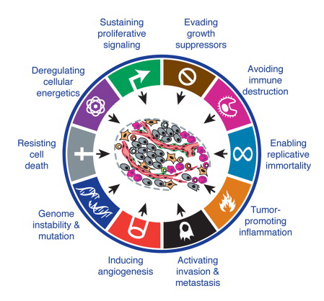
Hallmarks of Cancer
Sustained proliferative signal
Evading growth suppressors
“Hallmarks” are found in all/almost all cancers but NOT in normal cells
Disrupt checkpoints
Sustain proliferative signals
Enable replicative immortality
Alter the tumor microenvironment
Resist death
Promote continued tumor evolution and adaptation
Deregulating cellular energetics
Avoiding immune destruction
Resisting cell death
Enabling replicative immortality
Tumor-promoting inflammation
Genome instability & mutation
Inducing angiogenesis
Activating invasion & metastasis

Slide 35
Hallmarks of Cancer
Sustained proliferative signal
Evading growth suppressors
Changes in distinct cellular pathways underlie each hallmark
Hallmarks DRIVE cancer initiation and progression
Cancer therapeutics target one or more of these hallmarks
Deregulating cellular energetics
Avoiding immune destruction
Resisting cell death
Enabling replicative immortality
Tumor-promoting inflammation
Genome instability & mutation
Inducing angiogenesis
Activating invasion & metastasis

